Slide 1
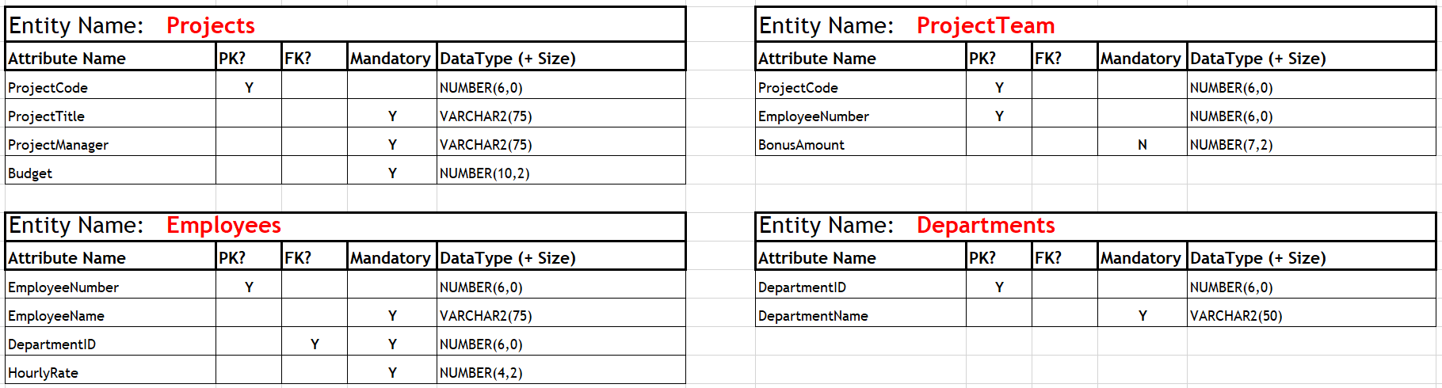
Project Management Data Dictionary

Slide 2
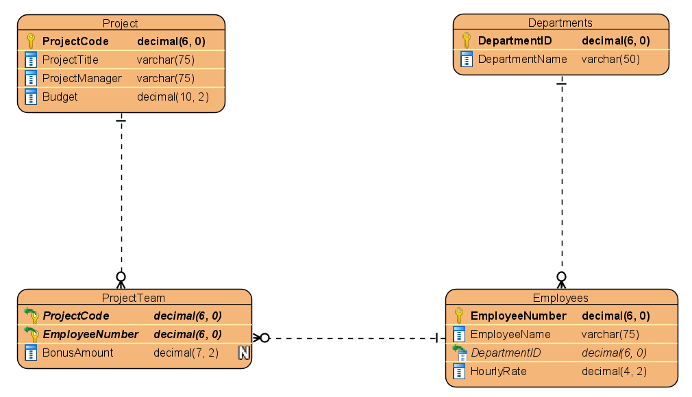
Project Management – ER Diagram

Slide 3
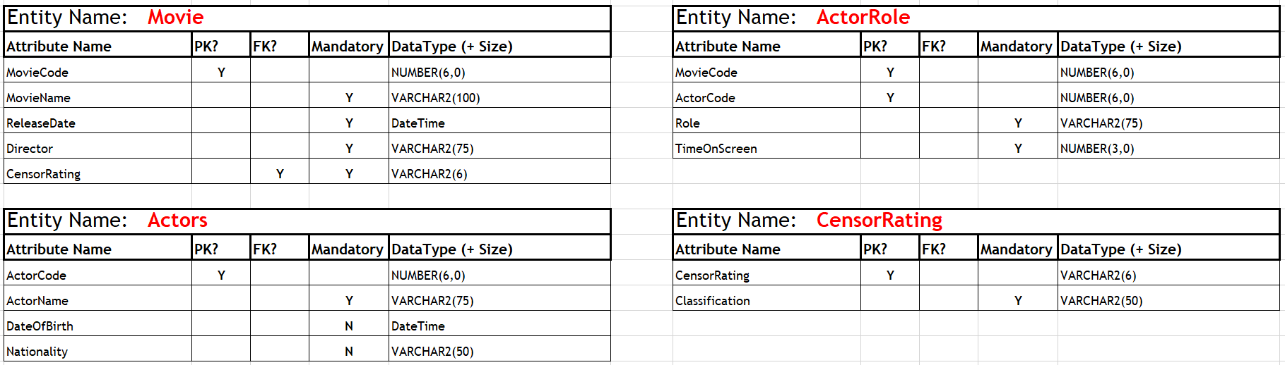
Movie Database Data Dictionary

Slide 4
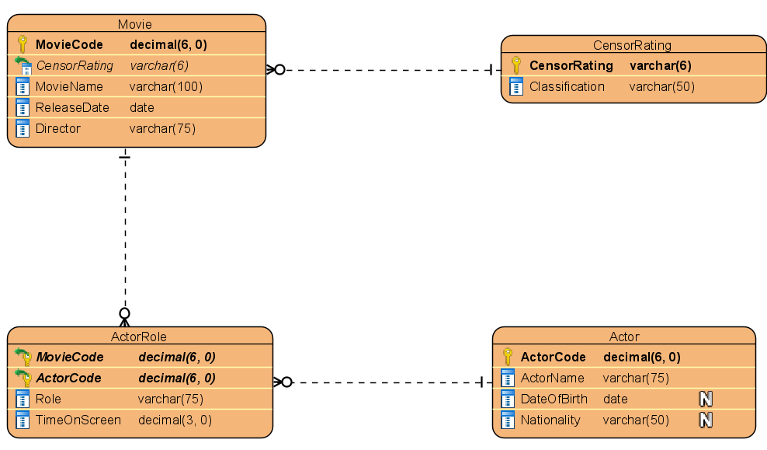
Movie Database - ER Diagram

Slide 5
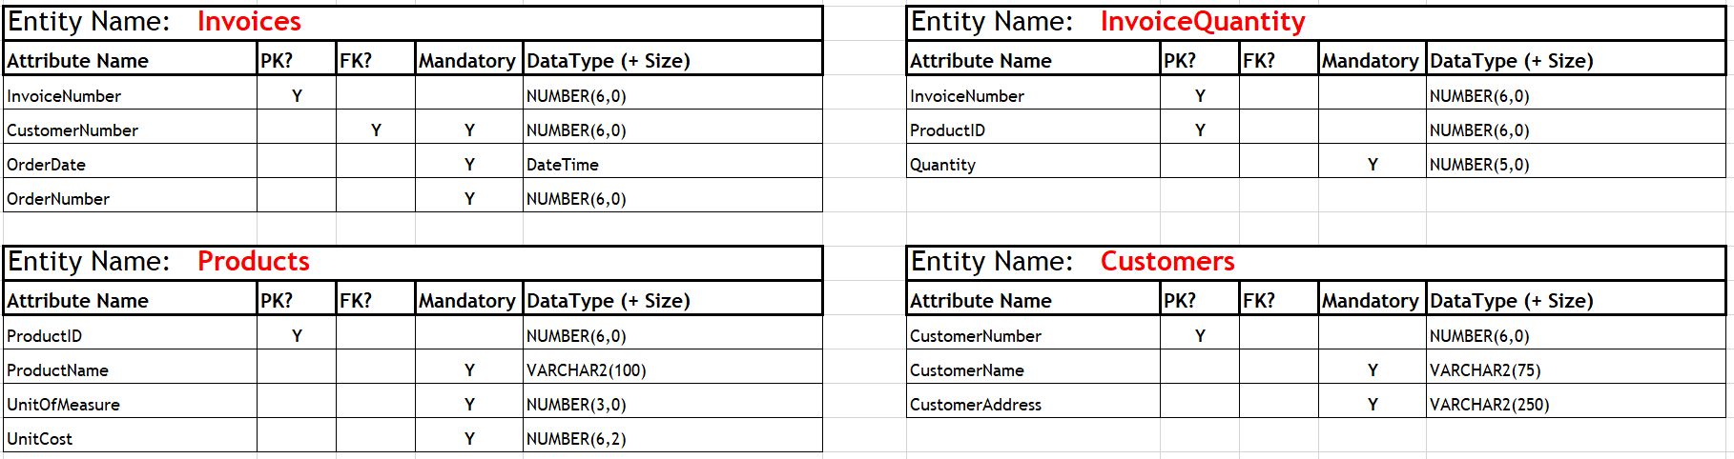
Soccer Supplies Data Dictionary

Slide 6
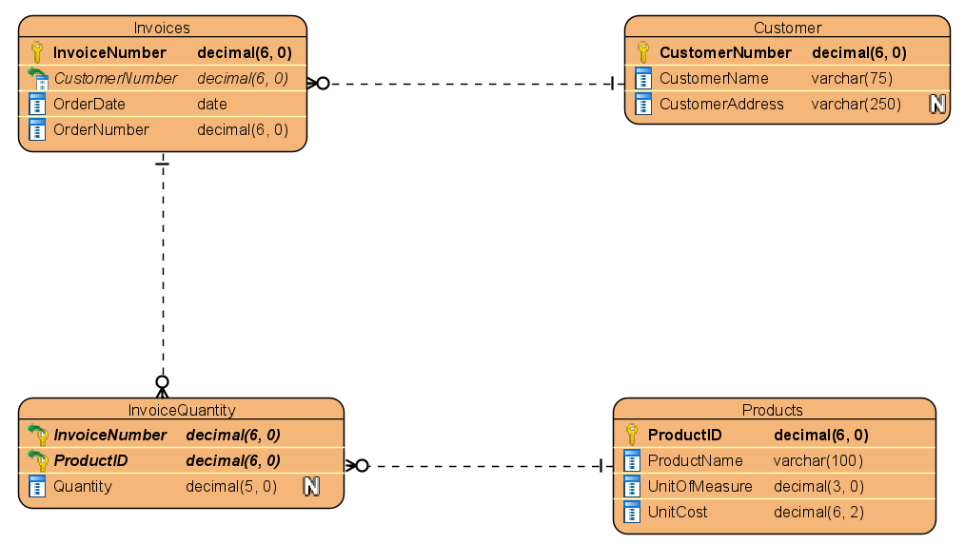
Soccer Supplies - ER Diagram

